Slide 1
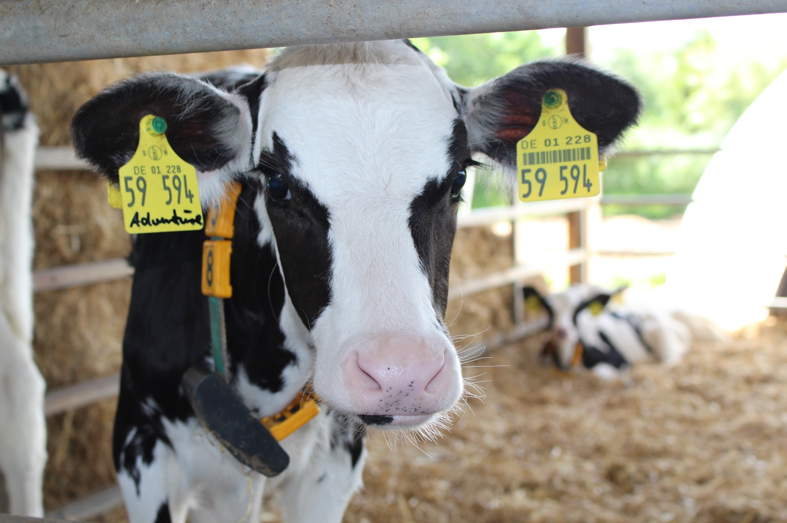
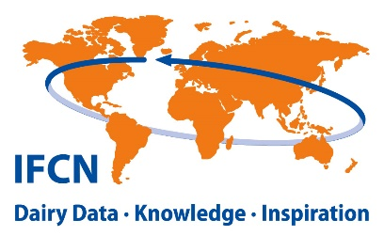

Presented by:
Short and long-term outlook –
Opportunities and challenges for future farming across different production systems
Dorothee Boelling
Senior Dairy Economist
Dorothee.Boelling@ifcndairy.org
Latvia Dairy Conference, November 3rd, 2022

Slide 2
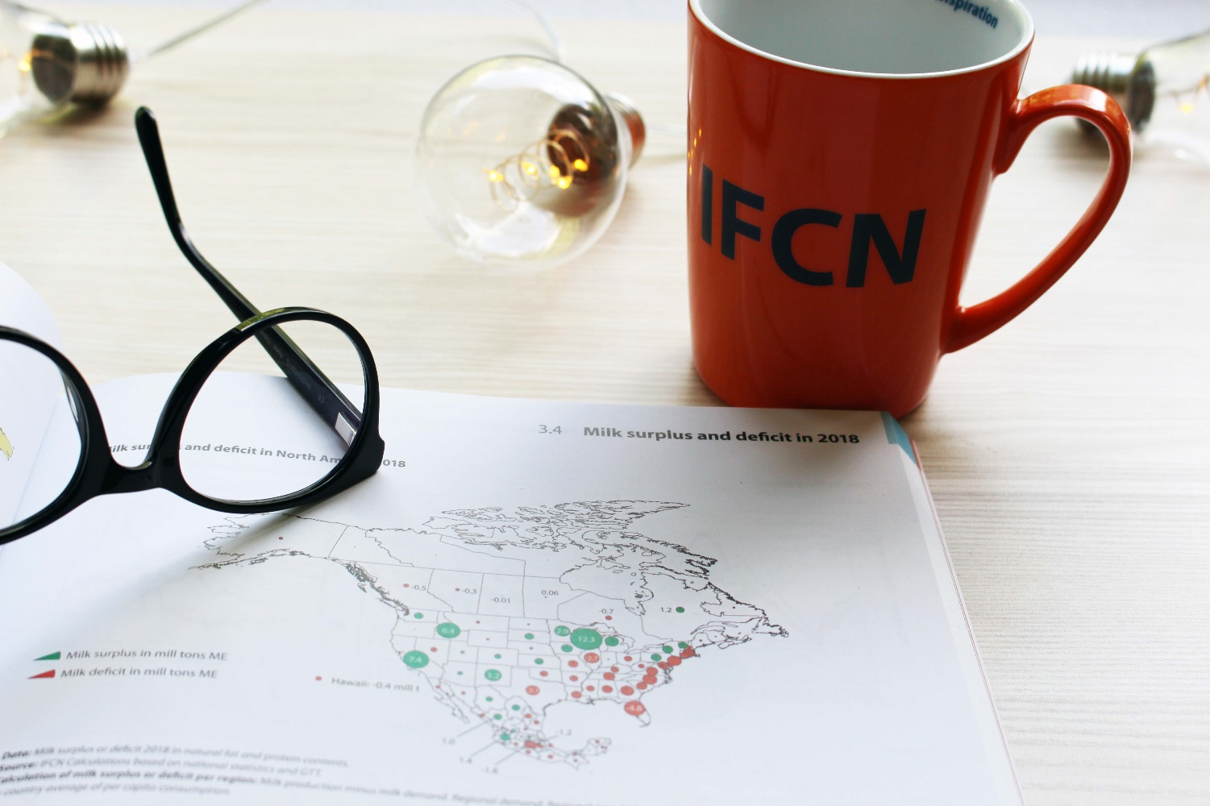
01
Introduction
02
Short-term outlook
03
Short and long-term outlook –
Opportunities and challenges for future farming across different production systems
Long-term outlook
04
Opportunities and challenges
Latvia Dairy Conference 2022

Slide 3
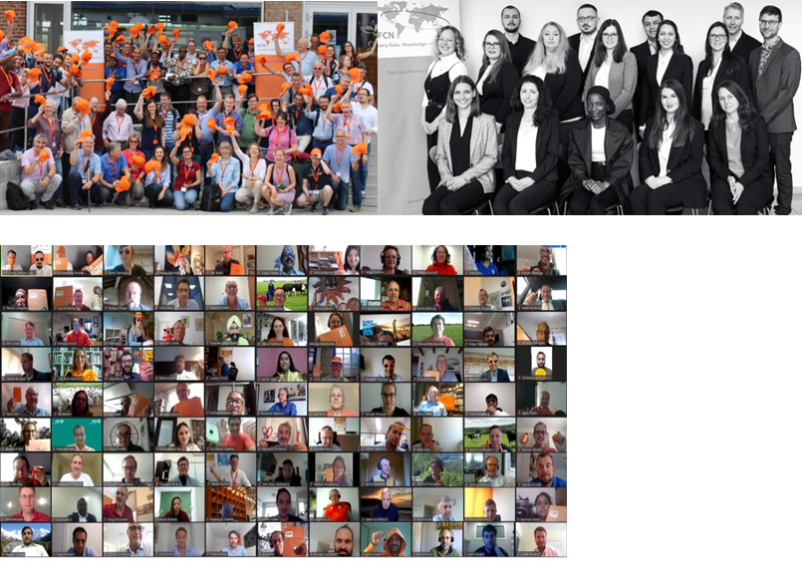
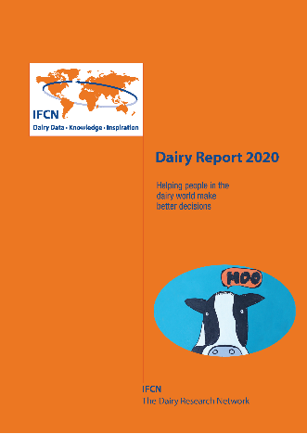
IFCN Dairy Research Network founded 2000
Mission: Helping people in the dairy world to make better decisions.
IFCN Approach: 3 Knowledge Pillars
> 140 companies: Network dairy-related companies and organisations
20 Researchers in the IFCN Research Center in Kiel
> 100 countries: Network of researchers

Slide 4
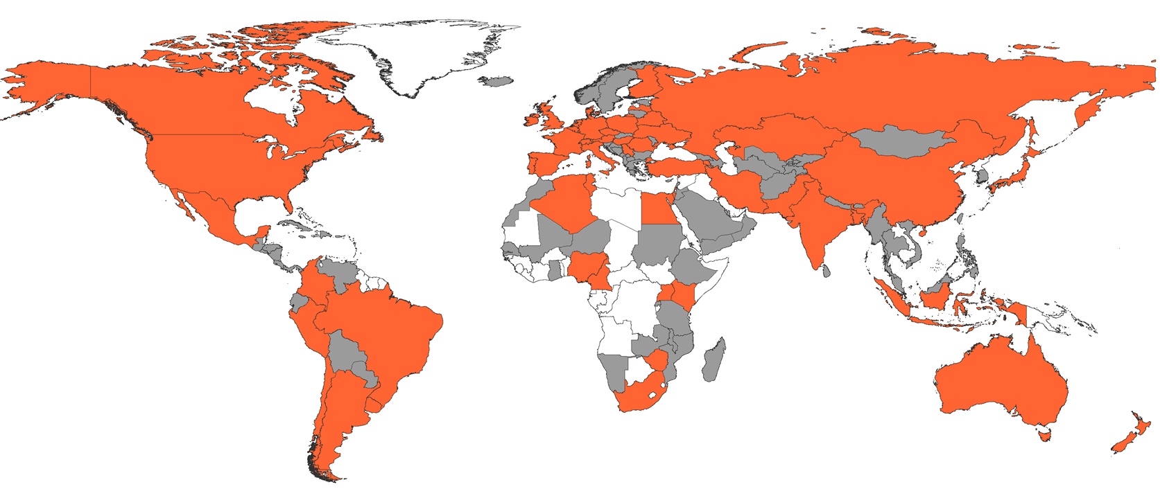
IFCN Research Network 2022
Dairy Farm Analysis
DE-30S
DE-154N
DE-700E
DE 1200E
US-1000CA
US-3000CA
US-80WI
US-500WI
CN-320
CN-2250
Dairy farm analysis:
174 farming systems/types
54 countries represented
90% of world milk production
Farm comparison analysis on
- > 300 variables/farm, > 600 result variables
- Economics: Costs, efficiencies, input prices
- Environment: Carbon / water footprint
- Social: Farmer income vs minimum wages
- Animal welfare: Somatic cells, cow longevity
- Resilience and sustainability: Start with buffer capacity
- Time series: data for >20 years
Examples of typical farm types
NZ-397 means a 397 cows farm in New Zealand
KE-2
KE-10
IN-2HA
IN-20HA
NZ-397
NZ-1194
BR-34S
BR-111S
Source: Data collection 2022
Notes:
Starting point for our analysis are typical farms – 54 countries, we included some new countries thanks to our partners and expand the knowledge about farm economics
For you to understand – we base farm economic analysis on at least 2 farms in the country or a dairy region, usually with abbreviation of the country and then the number which represents the number of cows.

Slide 5
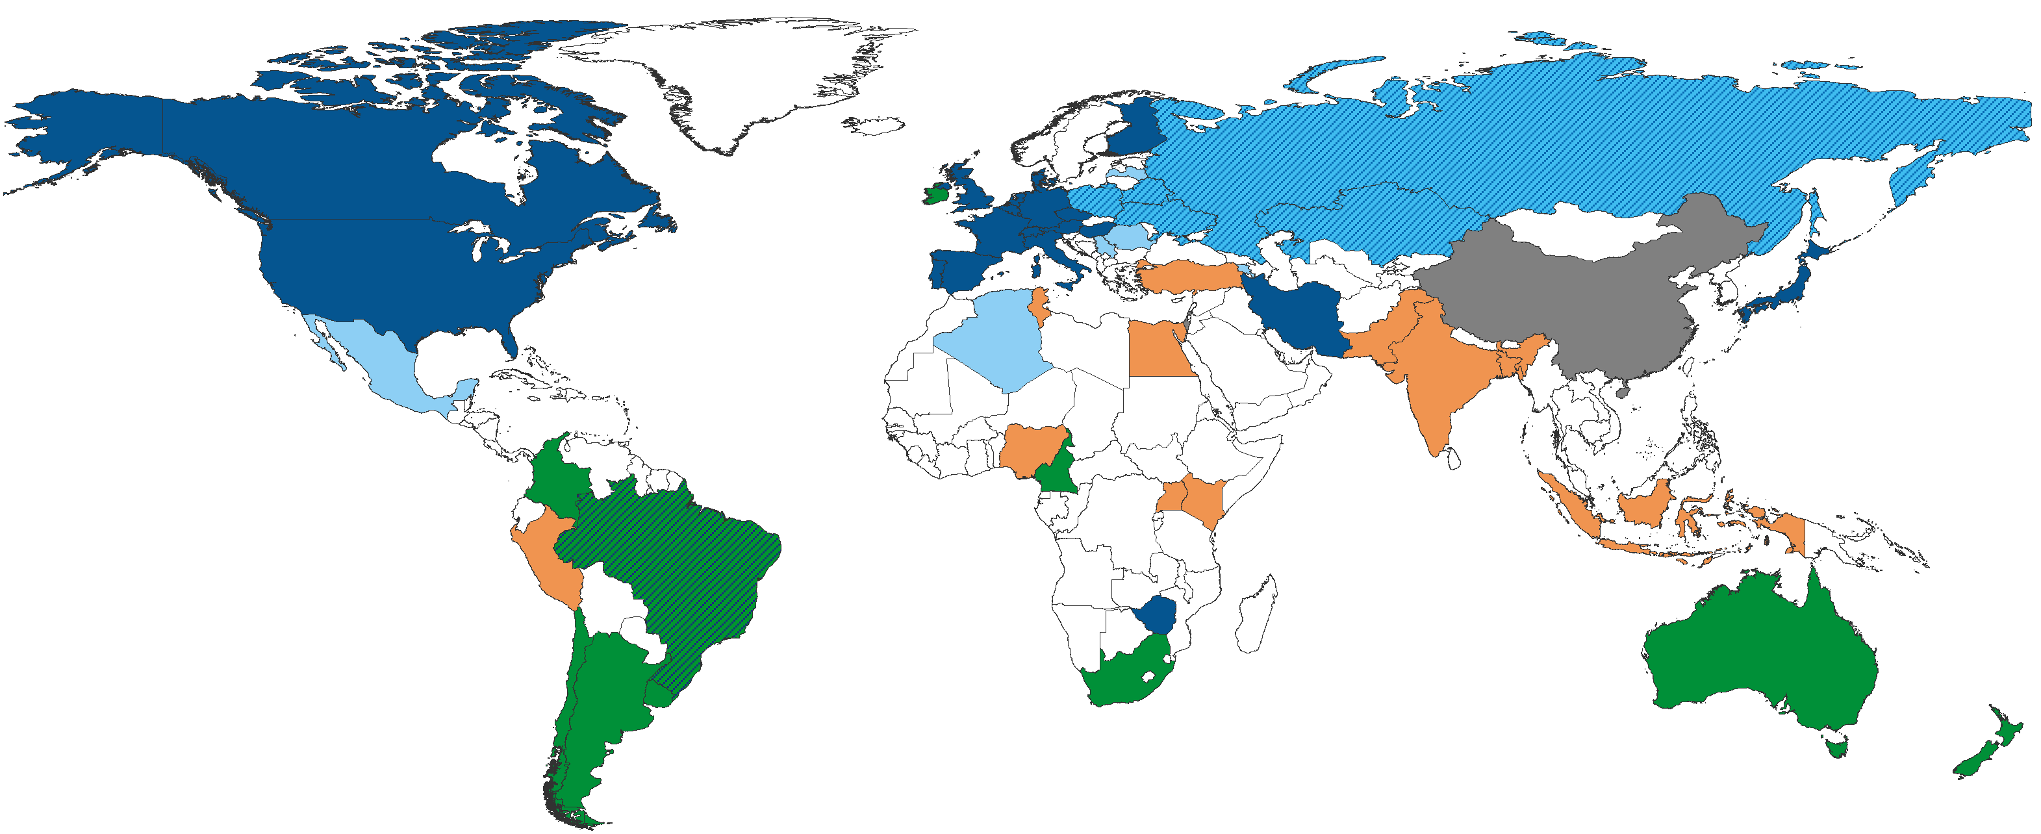
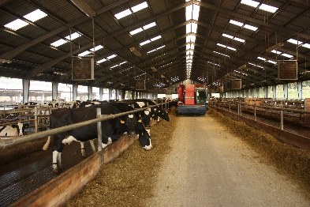
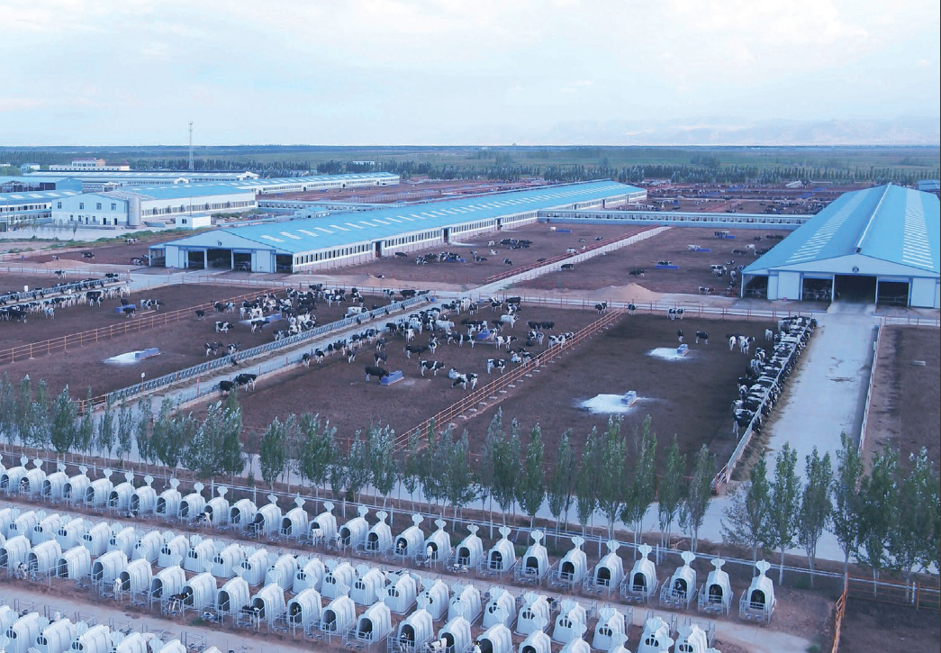
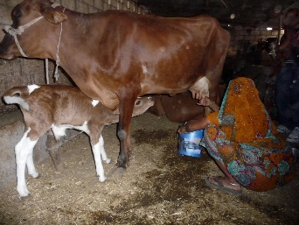
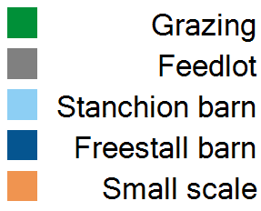
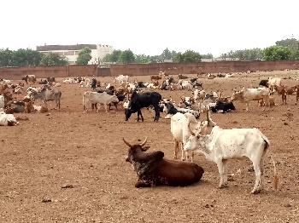
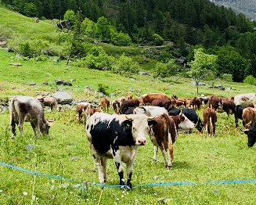
Different farming systems are defined by social, economic and environmental conditions
Farming system
on typical dairy farms
Notes:
Map based on typical farms from the data collection and average sized farms
One of the classifications, as mentioned before, it means the different starting point for farmers
Reason are pre-defined by social, economic and enironemtnal conditions
Source: IFCN Dairy Report; based on the data from the data collection (INP) and representing the typical (average sized) dairy farm in the respective countries

Slide 6
01
Introduction
02
Short-term outlook
03
Short and long-term outlook –
Opportunities and challenges for future farming across different production systems
Long-term outlook
04
Opportunities and challenges
Latvia Dairy Conference 2022

Slide 7





Our starting point …
The Dairy World 2021
vs. 2020
world milk price: +23.4%, +8.5 USD/100 kg
world feed price: +39.3%, +8.7 USD/100 kg
+2.9%, +25.5 mill t SCM*
vs. average 2015-2020: +21.5 mill t SCM
+3.2%, +29.8 mill t ME**
vs. average 2015-2020: +21.7 mill t ME
+1.3%, +1.3 mill t ME**
vs. average 2015-2020: +1.8 mill t ME
* SCM = Solid Corrected Milk with 4% fat and 3.3% protein; Cow and buffalo milk only
** ME = Milk Equivalents with 4% fat and 3.3% protein
Source: IFCN Dairy Report 2022
Notes:
Story: Change vs long-term average
Dairy shows resilience
Starting point for outlook – status of dairy world

Slide 8
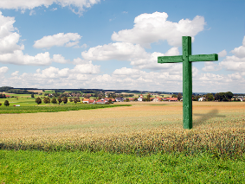



The new normal in the dairy industry
Farm successor challenges & sentimental shift
Ø loss of farms in EU in 2021: -6.3%
New environmental standards
Higher costs without an increase in productivity
Global competitiveness of supply chains
Price increase needed to keep farms competitive
External factors
Climate change, pandemics, and conflicts affect dairy supply and the dairy industry

Slide 9
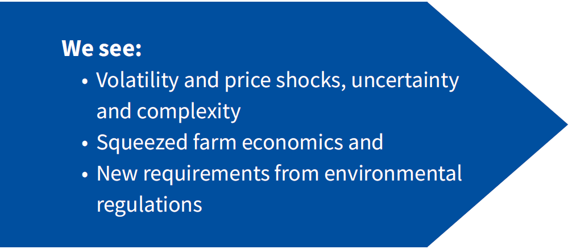
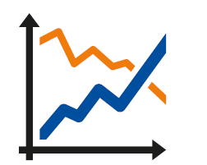

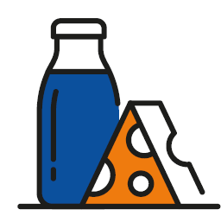
The new IFCN Dairy Outlook
Combining the best available knowledge and providing you with data and insights of what is driving the dairy world.
Forecasting helps to
anticipate changes, mitigate risks and achieve goals efficiently.
With IFCN, quality is guaranteed
Forecast accuracy reaches
  up to 98.6% for the world milk price
  up to 99.1% for the world milk production
Continuous updating of our modelling algorithms
The outlook at a glance:
• up to 12-months forecasts for
  farm-gate milk prices,
  feed prices,
  farm margins,
  raw milk pool sizes,
  dairy commodity prices,
• available for 65 countries
Notes:
Importance of outlook and why IFCN has developed / what is different vs others
What is included in the outlook service
Used by other companies already to stay ahead of the market

Slide 10
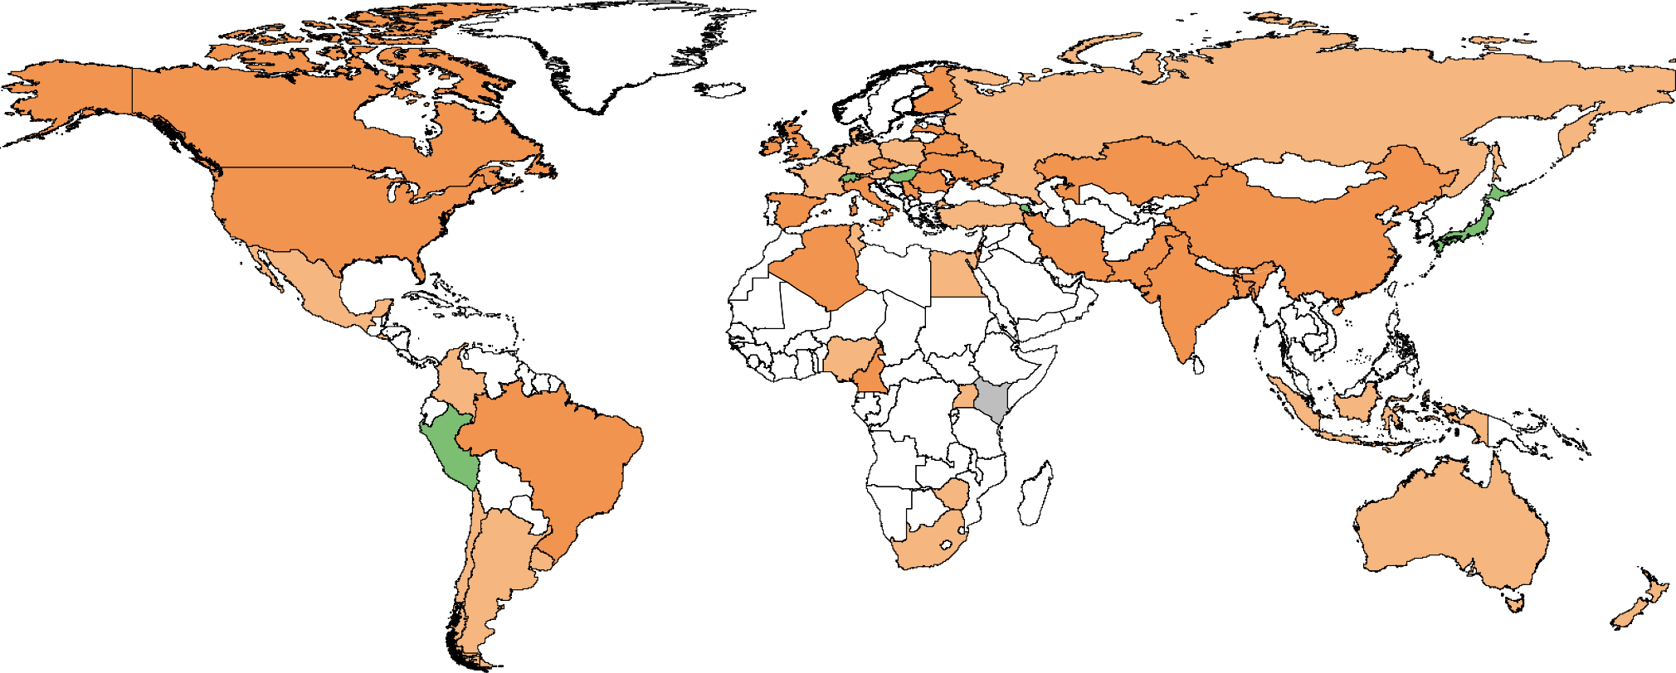
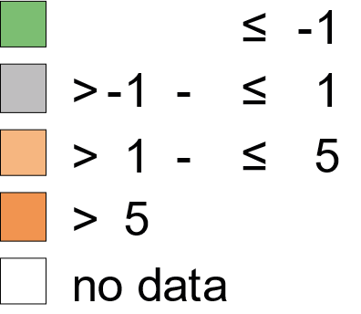
Cost of milk production increased almost everywhere (Ø >10%) and offset the increase in farm-gate milk prices in most cases
Change in Cost of Milk Production Only
Averaged sized typical farms (from 2 to 1,200 cows per farm)
Change in
Cost of Milk Production Only
For defined average farms per country
USD / 100 kg milk (SCM*)
*SCM = Solid Corrected Milk with 4% fat and 3.3% protein
Source: IFCN Dairy Report 2022
Notes:
Costs to high to produce milk at a decent level especially in major exports and not offsetting the increase in milk prices
Unusual year as everywhere COMPO was increasing
JP, Peru, CH lower: exchange rate driven and slightly increased labour productivity (=> labour costs down)

Slide 11


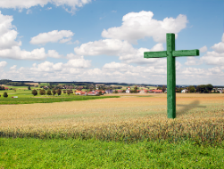





Future dairy commodity price developments depend even more on supply reactions and farm margins nowadays
IFCN’s outlook: integrating the entire dairy volume & price cycle – quantitatively and qualitatively
Farmers sentiment
Weather developments
Policy changes
Farm margins
Milk production volumes
1
2
Dairy stock changes,
Demand changes (GDP)
Trade policy changes
Change in
cost of production
4
3
Raw milk prices
Dairy commodity
prices
Quantitative judgement
+ 6-12 months outlook
Qualitative judgement
Source: IFCN Outlook Service
Notes:
Uniqueness of IFCN outlook – holistic cycle and integrating farm margins
Showing methodology of IFCN and what’s different with others

Slide 12
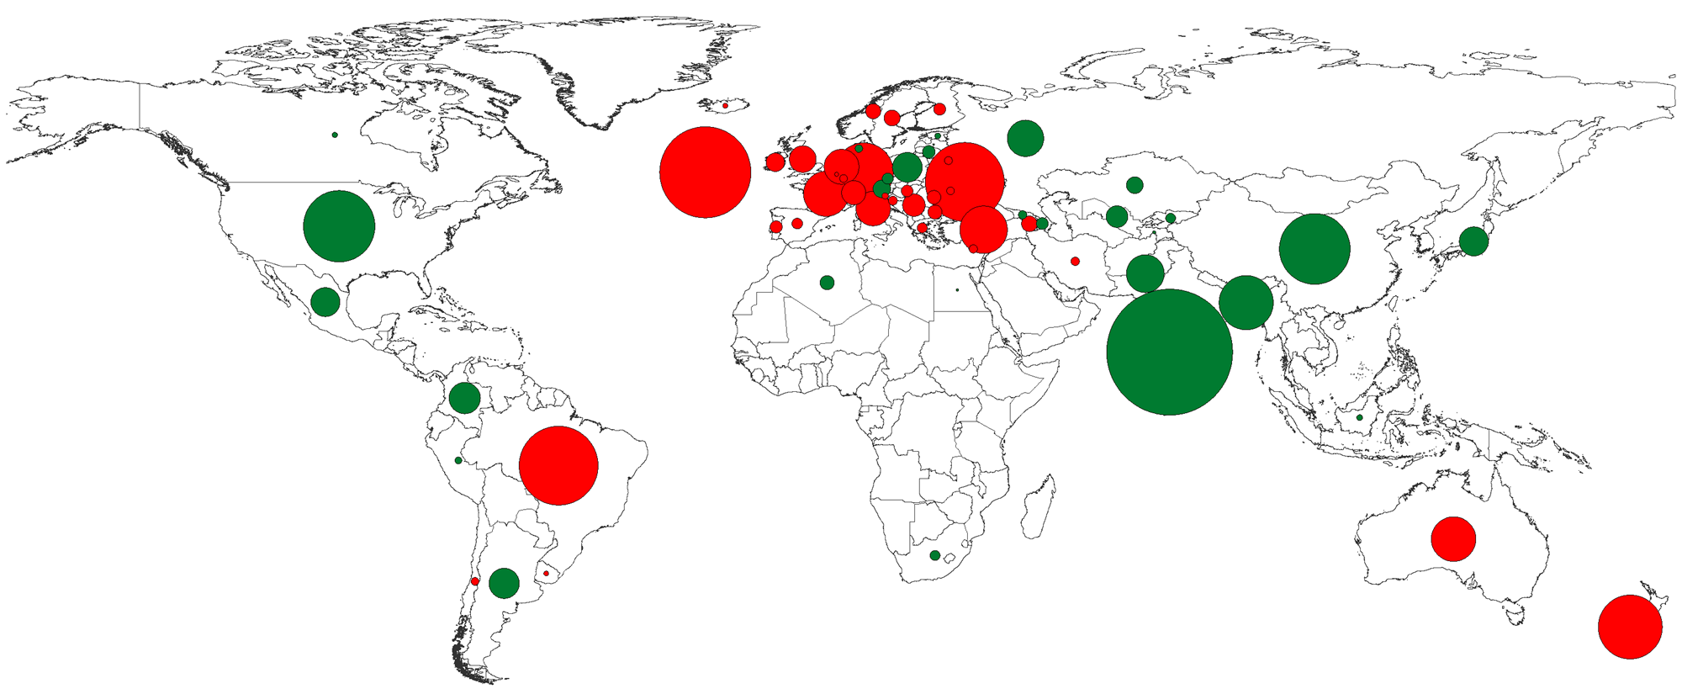
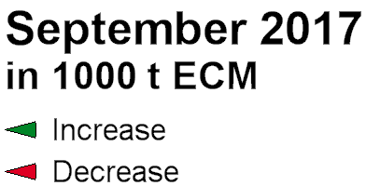
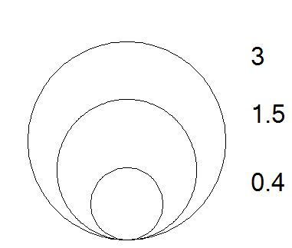
High costs, weather constraints, and environmental regulations weigh on farmers’ mood and lead to lower milk supply
- Independent of the milk price
Absolute changes in milk volumes
Increased milk contents
Record-high milk prices
Increasing costs
EU-27
+1.3%
-1.5%
+3.6%
Increasing costs
Hot and dry weather
Farmers’ mood
Investments in farms
Governmental support
Increasing costs
Jan-Aug 2022
in mill t SCM
-6.6%
Fewer dairy cows
High farm costs
Weather constrains
-5.6%
Global* milk supply growth vs Jan-Aug 2021:
-0.7% or -2.2 mill t SCM
Record high milk prices
Weather constrains
Policy regulations
* 63 countries (excl IN&PK) monitored monthly
Source: IFCN Monthly Real-Time Database for 65 countries, Status August 2022
Notes:
Cumulative lower supply from Jan-Jul 2022 vs average long-term growth rate per month
EU, Oceania, Ukraine, Brazil major drivers for global negative growth due to environmental constrains and high uncertainty
How much milk less than normally expected – huge amount of milk and main price driver – one reason for no rollercoaster if demand will slow down – there is clearly said no milk available even if demand will slow down
Note: supply is not a fixed variable anymore. Decline expected to continue for a few month and then slight recovery in 2023

Slide 13
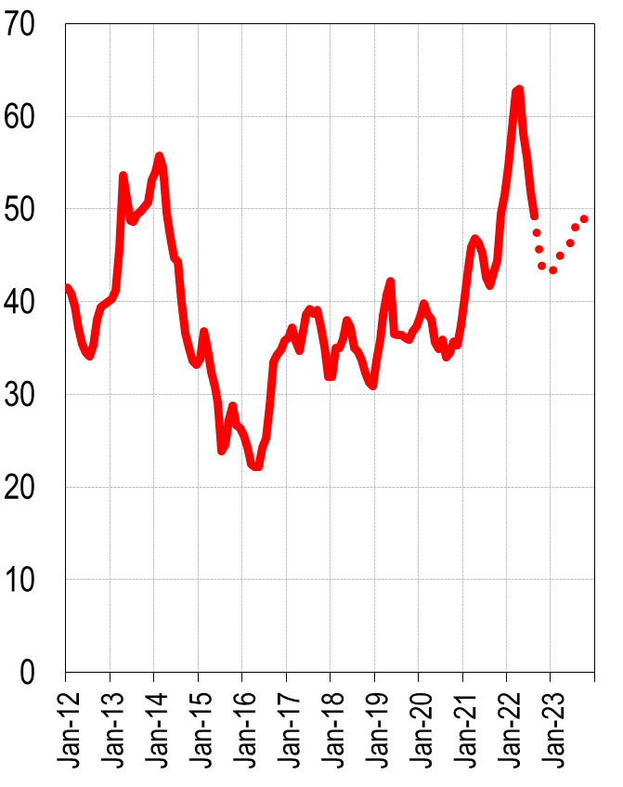
Different milk price scenario and probability of occurrence
IFCN World Milk Price Indicator
What is the chance for a smooth landing to new price level?
Average price fluctuation between 40-50 USD
  supply will recover, but not to previous growth levels
  and demand will slightly slow down, but recover afterwards
  Most realistic price development scenario
What is the chance for a milk price rollercoaster phase?
Highs in 2022, decline to levels <30 USD and a recovery to a new price level
  supply recovers much faster and stronger than expected
  and/or negative demand growth (resulting in an oversupplied market)
  Low probability: too many supply constraints
USD / 100 kg SCM (solid corrected milk: 4% fat, 3.3% protein)
Source: IFCN Monthly Real-Time Database for 65 countries, Status August 2022; IFCN Outlook Service
Notes:
What needs to happen for rollercoaster, dynamic wave, a bit noise? (with probabilities)
Future prices show decreasing / stabilising price level – impacted by lower demand and recovery of supply
IFCN forecast: staying above the 40 USD line due to supply constrains and slow down in dairy demand – but value of imports still high and record levels so broader middle class which will not shift that easily away from dairy
Inflated price level: no record-high prices yet yet which is also refelcted in farmers sentiment and we might come back to „normal“ infalted price level of around 32 USD
Which indicators to monitor to see if we will face a new rollercoaster?
Milk production volumes globally
Dairy demand and dairy import volumes
Dairy consumption and commodity production patterns
Governmental support which might stimulate milk production

Slide 14

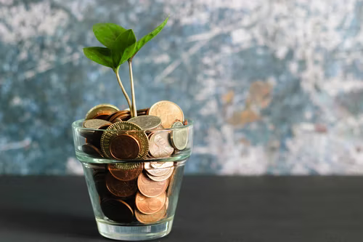
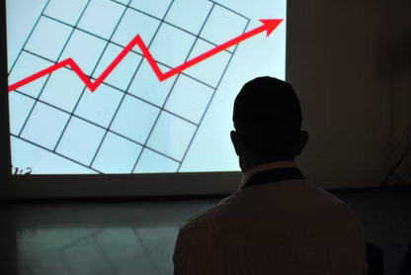

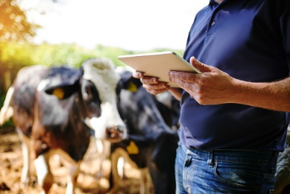

What does this price outlook mean for the dairy world?
Most farmers have to “fight” to create a decent farm income
„Battle for farmers”: Consolidation increases competitiveness
Dairy farm investments with focus on efficiency gains and cost savings
Understand the new normal and adapt to it
– Change is the only timeless truth – Be prepared for different scenarios –
What to watch out – early warning indicators
Raw milk supply developments due to high costs and adverse weather
Dairy demand /consumption patterns and commodity production patterns
Economic developments, geopolitical tensions and policy regulations
IFCN
Notes:
Health costs are impacting farmers costs – increase, but it can have a positive benefit and increase the animal health and welfare (like vaccines)
During these volatile and inflationary times: risk management is key to survive
Knowing and managing costs and their influence on farm economics and milk supply can secure a decent income
Price level what does it mean for the industry
Variables to be observed for next 12 months – which need to be observed: drought, demand, production patterns, supply developments, economic developments, geopolitical tensions, policies

Slide 15
01
Introduction
02
Short-term outlook
03
Short and long-term outlook –
Opportunities and challenges for future farming across different production systems
Long-term outlook
04
Opportunities and challenges
Latvia Dairy Conference 2022

Slide 16
Key Scenarios to predict the future
+
Demand Strong preferences for dairy
Starting point
of scenario analysis
Income
Restricted
Pro dairy
Demand / supply growth
like 2010 - 2020
e.g. environmental regulation (Green Deal)
-
+
Policy &
Economics
„Stagnation
or shrinking ?“
Rich and
Picky
e.g. long-term economic recession
e.g. shift to more veganism
-
Demand More dairy-free diets ( + less food waste)

Slide 17
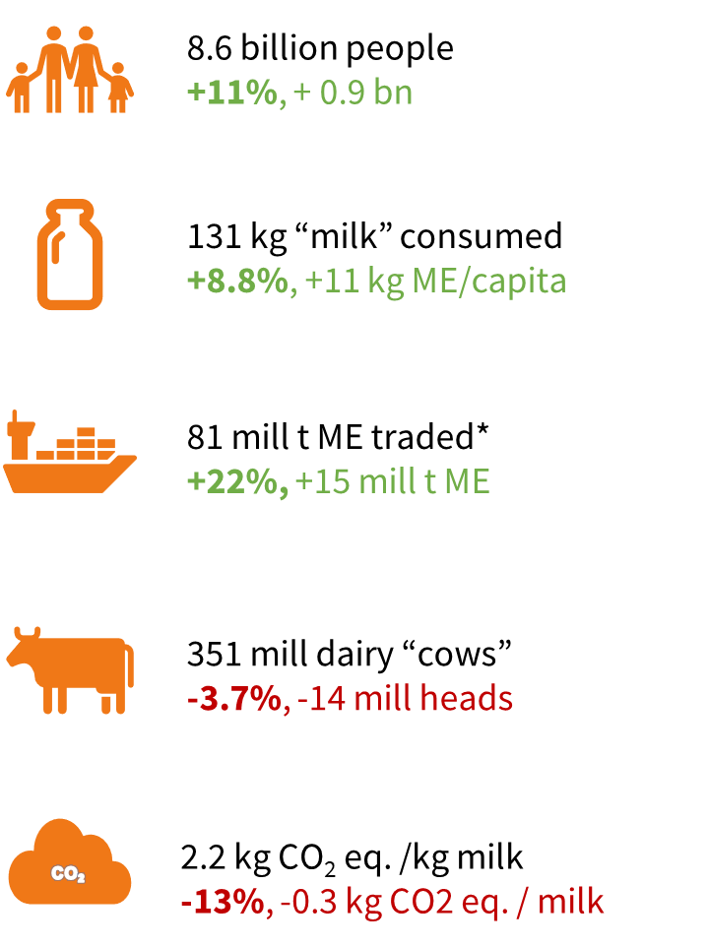
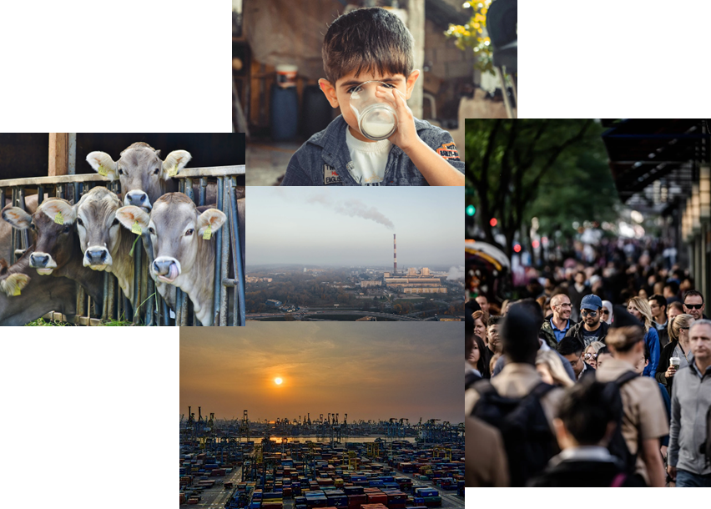
The Dairy World in 2030 vs. 2020
Our starting point…
+21% more milk produced and consumed
+192 mill t milk SCM = 2x USA today

Slide 18
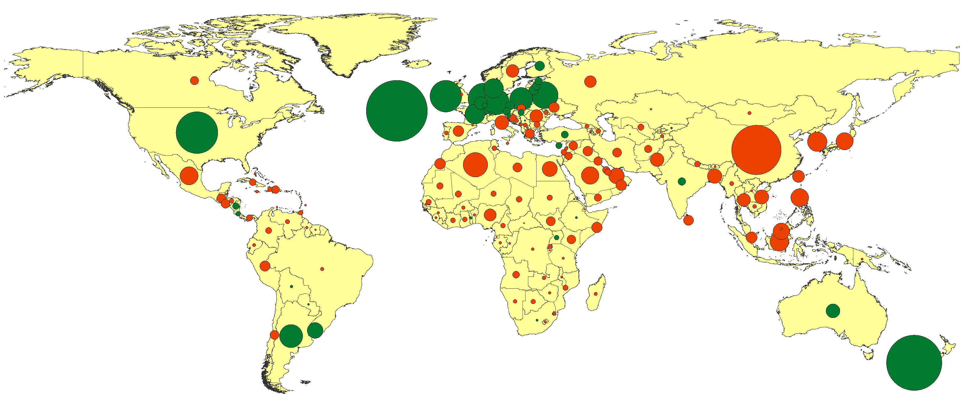
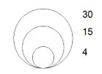
Dairy Surplus & Deficit in 2030 and its game changers
Protectionism & long term impact of war in UKR
Environmental & animal welfare regulations
Development of artificial dairy
EU-27
IT technology in farms
+29
+14
Shift to more veganism
-19
East &
South-east Asia
Africa
-38
in mill tones ME
Increased climate shocks & food deficit
-16
Net exporting countries
Net importing countries
+4
Increased climate shocks & food deficit
Long-term economic recession
+24
Supply = Demand in 2030
Environmental regulations

Slide 19

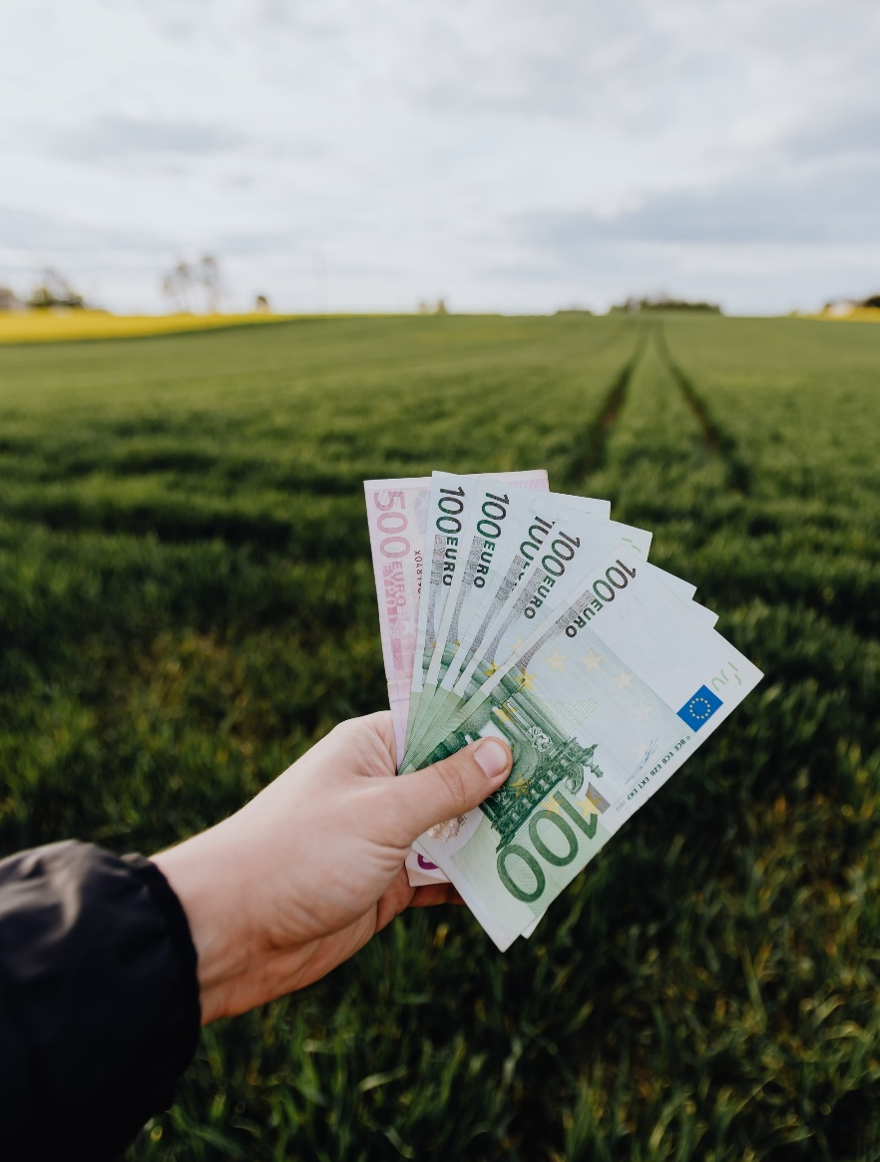
More pressure expected on EU dairy farms
Greenhouse Gas Emission Reduction
Farm input costs up
Policies & Regulations (Green deal)
IFCN
Less milk ? How much?
19
Notes:
Milk in EU dependent on policy:
Pro dairy: +0.5 % per year!
Green deal: -1% per year – 100% self-sufficiency, 20 mill tons less for export, world milk price ~55 USD

Slide 20
What will be the “new normal” in the dairy future?
Overall: We are at crossroads
Decline in supply of main suppliers, higher demand
Price will increase globally, but also cost of compliance
Consequences – Food Security/Health:
Net less nutrition (animal protein) for the world
Impeding the realisation of UN SDG’s no hunger and quality nutrition for all
Consequences – Emissions:
More CO2 emissions per kg milk globally if production in emerging regions increases
Reducing production in developed regions
+21% dairy demand growth possible - but who can produce at affordable prices?

Slide 21
01
Introduction
02
Short-term outlook
03
Short and long-term outlook –
Opportunities and challenges for future farming across different production systems
Long-term outlook
04
Opportunities and challenges
Latvia Dairy Conference 2022

Slide 22
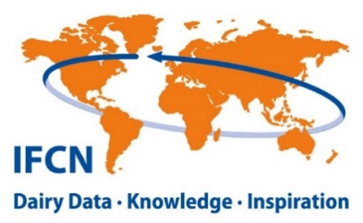
Different cost structure can be a (dis)advantage for each farming system
Share of cost components on total dairy farm costs
Increasing costs are a challenge, but unavoidable:
Feed costs go up (availability expected to decrease)
Fertiliser and energy: worldwide shortage
Labour costs: rising minimum wages
Better animal welfare necessitates investments in barns and equipment
New (supra)national policies require investments and costly changes
Source: Farm Economic data, under validation 2022
Notes:
compare DE and PL → PL lower costs because of generally lower cost level; but: less machinery costs as more work is done manually (see later; labour productivitiy etc)
PL and IN have same total costs (IN is not a cheap production country!); feed and also land costs are higher in IN; other costs (overhead costs) lower; labour still similar (see later)
IN to NZ: NZ manages to have lower costs than India; share of feed costs and labour down

Slide 23
Lack of feed and fertilizers might ask for changes in concentrate use in more intensive systems
Feed rations for typical farms
Feed rations differ strongly between different production systems
Different strategies to overcome this dependency:
Adjust the feed ration with alternative feed stuff (by-products)
Efficient use of manure and slurry on farm
Less concentrates, more roughage
Creating new optimum between milk yield and feed intake
World fertiliser prices
Increased sharply and will affect production costs
USD / 100kg
Notes:
Short- or long-term changes on the farm?
Countries with a high share of concentrates in the ration depend more on the international trade regarding fertiliser and different concentrate components
DAP: Diammonium phosphate (NH4)2 H2PO4 : 18% N; 46% P2O5
TSP: Triple Super Phosphate (45% P)
Urea: 46% N
Fertilizers 4-5% of the total costs in PL and DE
If prices tripled (with same input), increase of ~5USD /100kg milk
In 2021: no impact yet because of contracts from autumn 2020. Will be visible after this year’s harvest

Slide 24
Feedlot farms are highly dependent on the domestic and world feed market volatility
China: Milk and feed prices
Total feed costs
Incl land, labour, machinery, fertiliser etc
Example: China
Feed price increase continued
Availability of feed limited due to low imports because of congestion in major ports and other logistical challenges
→ Negative impact on national milk supply
Concentrate + roughage
+16% in 2021
75% of
total costs
In CNY / 100 kg
Notes:
Feed price goes up, while milk:feed price ratio turns unfabourable
In China feed costs are 75% of the total costs, and last year it increased only 16% due to delayed effect and it is going to be felt even more this year.
Additionally, CN depend on imports which is challenged with current events in ports and disturbed supply and logisitc chain.
In 2021, 16% increase in feed prices which might not yet have had an effect last year (long-term feed contracts)
milk: feed price ratio turned unfavourable

Slide 25
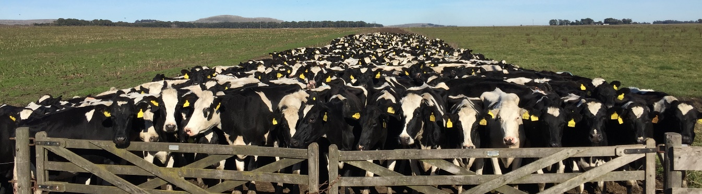
Grazing farms produce independent of the world market and highly depend on the weather
Argentina: YoY change in milk supply
Advantage of grazing farms
Little concentrate feeding
Less dependent on the world grain market
Challenges of grazing farms
Highly dependent on the weather conditions
Dry matter intake limited, thus moderate milk yields
Logistics: herd size and land availability
El Niño years
Notes:
Recent months positive -
Chart – change – some years negative???
2009-10, major 2014-16, 2018-19
On one side
Milk production is dependent on the regional weather conditions, adverse weather conditions limit milk supply (El Nino)
Milk supply independent of the (political) world situation
Herd size is limited due to the logistics of having cows out in the field
Grazing farms are dependent on land (and capital) availability
Dry matter intake of cows is limited, therefore a diet based on grass without much concentrate does not allow high milk yields

Slide 26
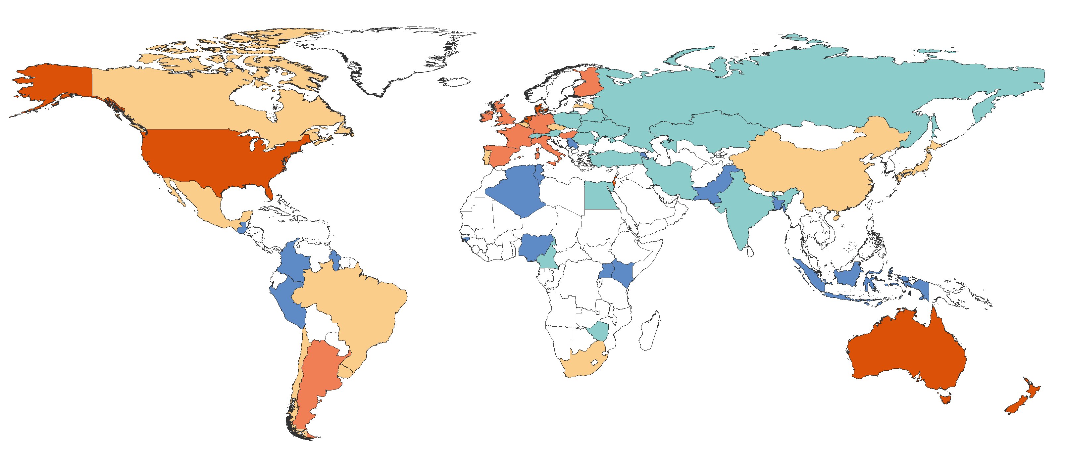
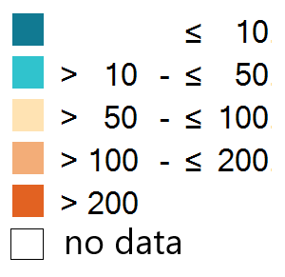
Labour is a rising issue in both developed and developing countries
Labour productivity kg milk/hour
Why is labour an issue?
Urbanisation
Demographic structure
Low wages
24/7 shifts
Lack of skilled labour
Immigrant labour
kg milk/hour
Notes:
Total scale varies between <10 and >400 kg milk per hour (huge spread, depending on production system, mechanisation, skilled labour, also milk yield)
Top countries: NL, NZ, DK (use of a lot of technology or grazing)
Small scale farms often <10 kg SCM/hour: low mechanisation and low milk yields, one full time employee generates/produces 6-8 tons milk/year
Transition countries: Eastern Europe and parts of Asia: higher milk yield, more mechanisation, but still on a lower level as in W-Europe or USA. Also climate (cold and long winters) or region (mountains) lower the productivity

Slide 27
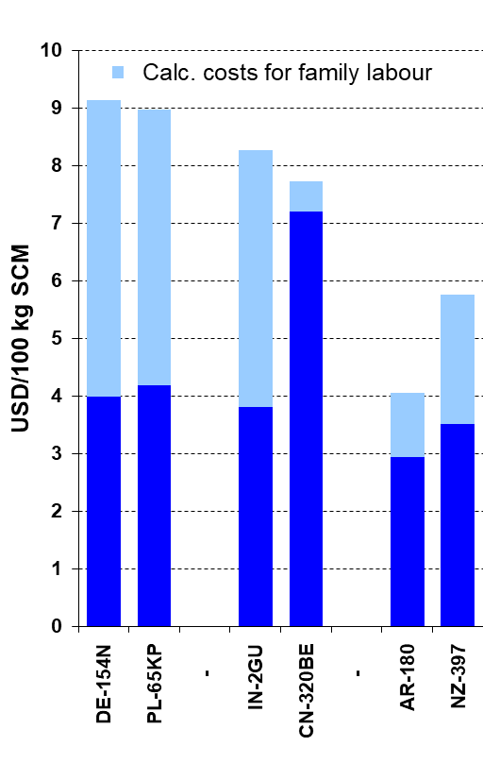
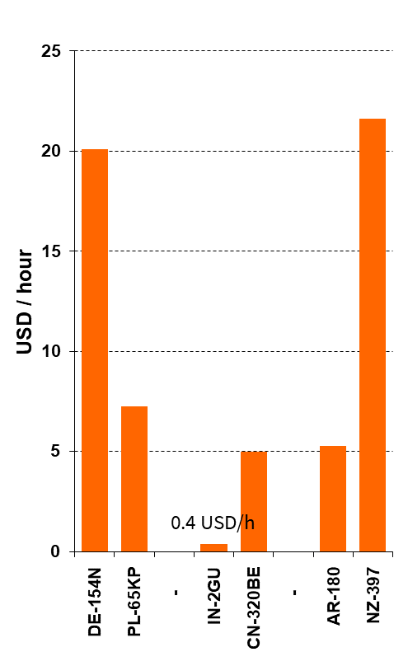
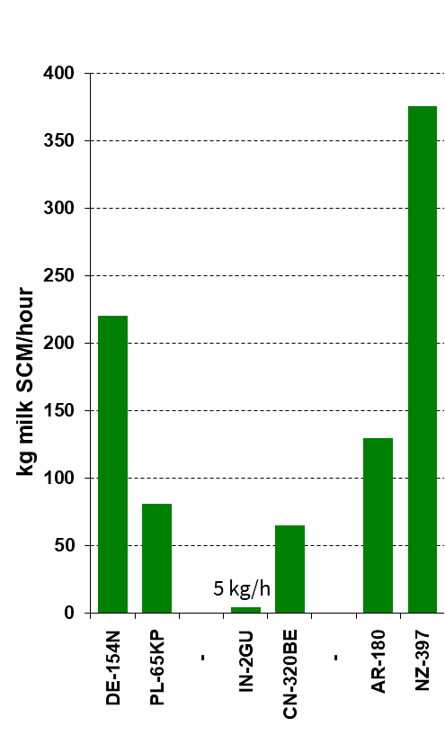
Increase in labour productivity comes with new technologies and skilled labour
Labour cost
Average wages on the farm
Labour productivity
Notes:
Labour costs similar – different wages and labour productivity
Potential to reduce
Labour is ~15-20% of total costs
DE and PL: same labour costs, but different wage level and labour productivity (both factor ~3)
IN: also similar costs, but extremely low productivity and low wage rate. Vulnerability of small scale farms: when salary increases >0.3 USD/hour, they cannot make it
NZ: extremely high productivity (grazing, little fodder conservation) allows high wage rates and labor costs are still ~60% of Germany or PL
→ the increase in productivity allows higher wage rates

Slide 28
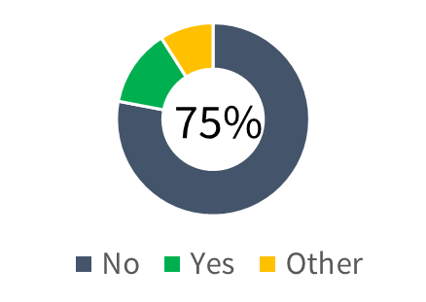

Education of young farmers is needed to become better managers and/or to get subsidies
Is there any support for young farmers in your country?
Is formal agricultural training required?
Many young farmers want
to improve their knowledge and farm management skills
in order to develop the farm successfully in the future
Special
Yes
No
Year Box, 50 countries represented
Notes:
In most countries (75%), no formal agricultural training is needed to take over a farm
In 13 countries, training is needed, either to take over or to be able to apply for subsidies/support

Slide 29
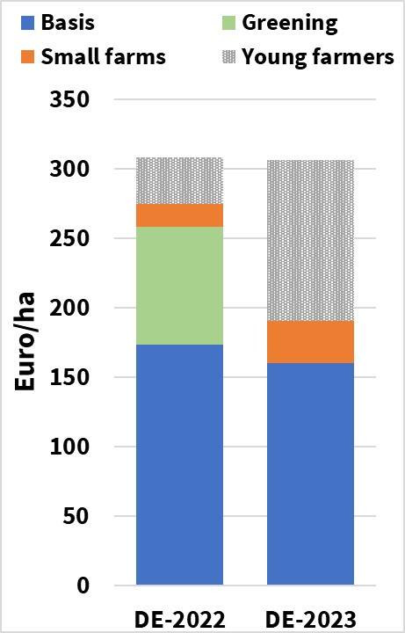
The new agricultural policy in the EU shows a shift towards small, young, and green
Decoupled subsidies on a farm in Northern Germany with 154 cows
New CAP 2023 – 2027: reshuffle of payments in line with „Green Deal“ and „Farm to Fork Strategy“
Who benefits
Young farmers
Small farms
Environment, if implemented
Impact on dairy farms
Loss of subsidies
Financial benefit of green practices unclear
Decrease in EU milk production

Slide 30
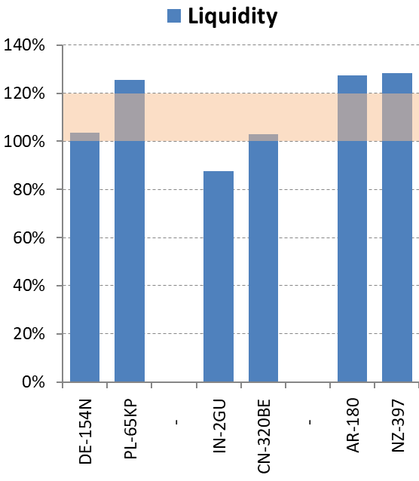
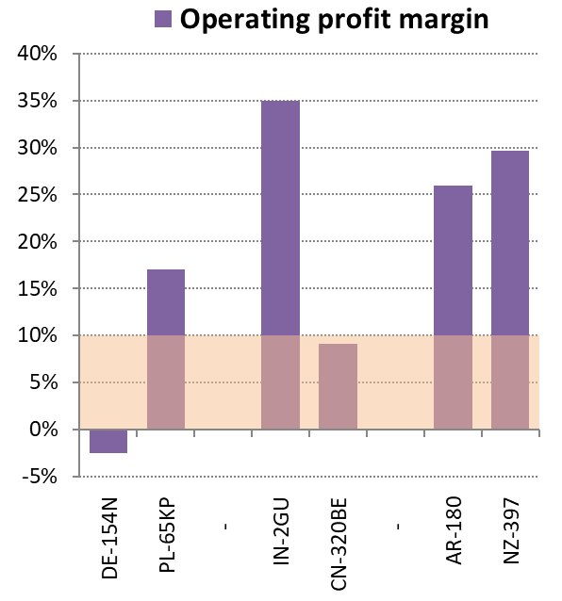
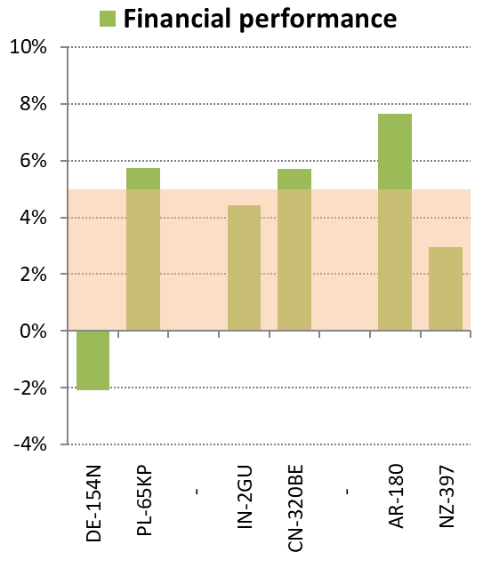
Farmers need to be responsive to market volatility and show resilience / buffer capacity
Short term:
Cash flow and working capital
Medium term:
Cost control and relative resilience to milk price volatility
Long term:
Challenge / opportunity for making investments and/or structural changes
Notes:
1st stage: Buffer capacity: ability to react to shocks. This is measurable and shown here
2nd stage: adaptive capacity (adapt to major disturbances, the new situation); 3rd stage: transformability (transform the farm when the conditions do not fit anymore)
Examples for buffer capacity:
DE: cash flow ok, but negative for mid and long term
IN: cash flow too low, but farm is ok in mid and long term
PL, AR, NZ: farms are doing fine, PL and AR especially long-term

Slide 31
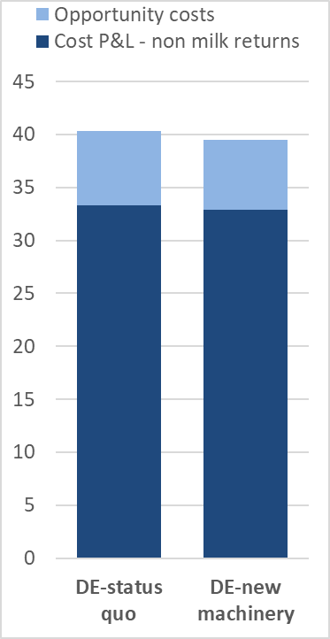
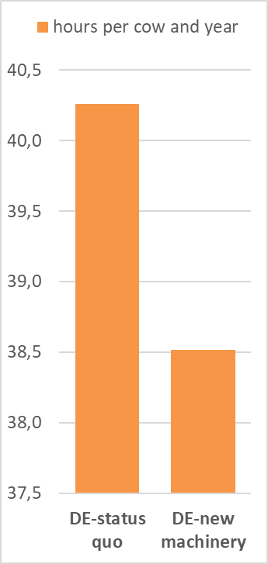
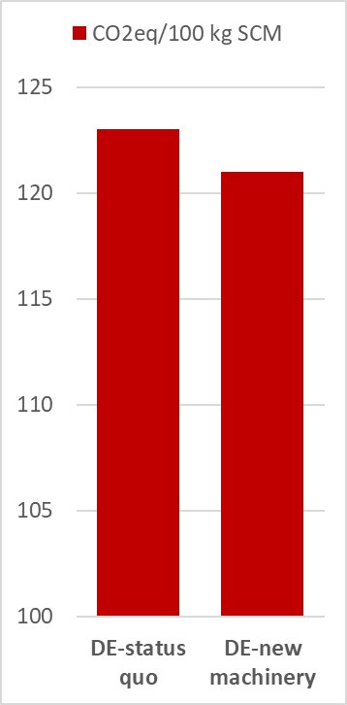
New investments in farming practices are meant to make dairy more attractive
How to find out how investments affect different aspects of the dairy farm
Economic aspect
Social aspect
Environmental aspect
EUR/100 kg SCM
Example
A robot pushes the roughage back into the trough several times a day, enticing the cows to eat more and saving labour
Machinery investment: 18,000 EUR
Milk yield: + 2%
-0.8 EUR
-2%
+6.9
-4%
Source: Provisional figures based on typical farm data
Notes:
Tool to identify future farming systems – scenario or what-if analysis
Analysis on 3 aspects: economic, social, environmental
What-if analysis – Technology impact for a dairy farm + sustainability
Results
Costs: -0.8 EUR/100 kg milk
Labour: - 4% (~2 hours/cow/year)
Carbon emissions: - 2%/100 kg milk

Slide 32
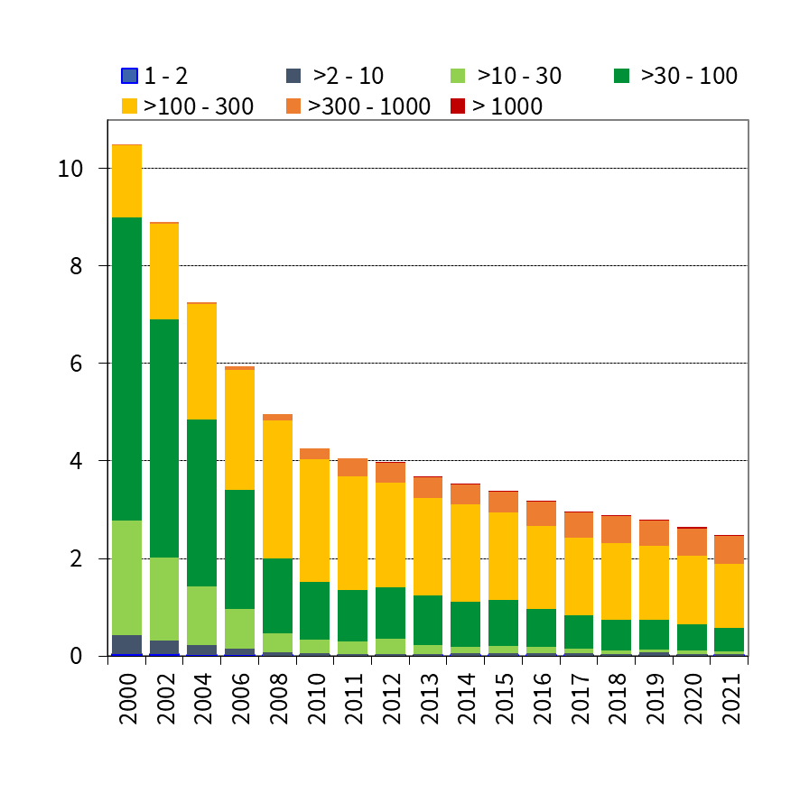
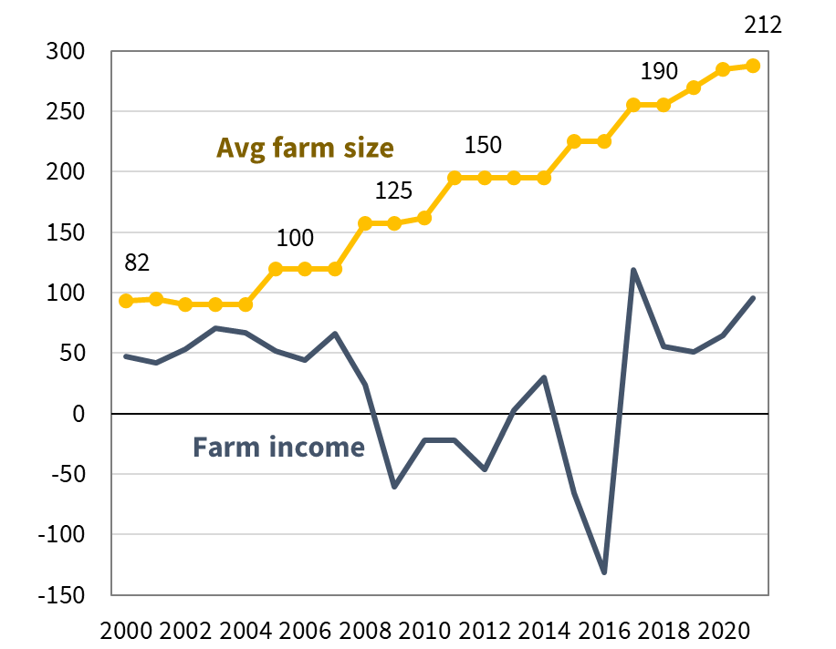
Dairy farm income has not seen an improvement for 20 years despite an increase in herd size and milk yield
Dairy farm income on a typical average Danish farm
Number of dairy farms in Denmark
in IFCN Standard size classes
+6.9
In 1,000 USD
In 1,000
Ø change since 2012
+22
-103
Source: D5.1 IFCN Farm Economic Database, status October 2021; D3.7 Annual Farm Structure Data 2022, status March 2022
Notes:
In general, costs are increasing per unit, price suffers from volatility.
Left chart – in blue is farm income fluctuating and stagnating around 50,000 USD per year
At the same time – farm size and yields are increasing. So for a farmer to secure the livelihood of their family and his/her salary, farm needs to grow
Second chart
What does it mean: development of the different herd size classes. Small farms (<100 cows) are decreasing, BUT the number of large farms (300-1000 cows) is also decreasing. So these farms either grow to farms >1000 cows or they cannot make it and disappear. On the other hand, large farms grow even larger; size for herds >250 cows increased from 350 cows/herd in 2012 to 410 cows/herd in 2021

Slide 33
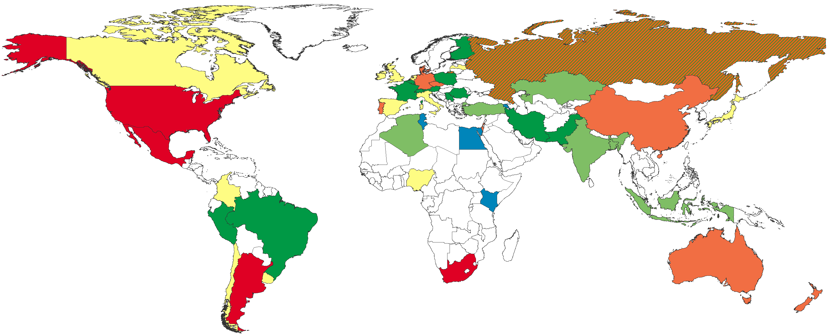

What is the future farm size?
Guesses from the IFCN Researchers in 50 countries
For family farms: what is the minimum future farm size (in 2030) needed to generate an income covering the family needs?
Farm size
Year Box, 50 countries represented

Slide 34


Summary
Milk production and dairy can only prosper if each region identifies its own next generation production system regarding the herd size and farming intensity
Future farming systems should have the ability to overcome current and future challenges, e.g. availability of production factors
Developing a successful future production system is an engineering task with a social and environmental additive where all the ideas and data are put together

Slide 35

Thank you!
www.ifcndairy.org

