Slide 1

Estonian NRN self-assessment
Meeri Klooren
Nordic-Baltic Rural Network meeting
12-13 September 2016, Jelgava

Slide 2

Content
Overview of the Estonian NRN self-assessment process
Our self-assessment system - the pros and cons
What can we do different next time - Lessons learnt

Slide 3
Estonian NRN self-evaluation system is based on:
Estonian RDP 2014-2020 chapter 17 - National Rural Network monitoring table (compliance with common monitoring and evaluation system - table B2.3: Table to monitor technical assistance)
  www.maainfo.ee/public/files/TU_delegation_RDP_19-10-2015%20Ove%20Poder.pdf - overview about Estonian RDP in English
Data collection for ENRD Common Network Statistic (CNS) (self-evaluation)
We complement the previous data with necessary information; contribution of network (activity level) + written feedback on event submitted after the event
NSU prepared monitoring documents and developed the monitoring system according to the aims of Estonian Rural Network

Slide 4

Estonian rural network evaluation system
Evaluation of National Rural Network
Collected by Estonian University of Life Sciences (RDP-permanent evaluator) / Estonian Ministry of Rural Affairs (subscribes special survey)
RDP evaluation report
ENRD Common Network Statistics + NSU self-evaluation
Collected by Estonian NSU
Submitted to ENRD
Data for European Commission (mandatory)
Collected by Estonian NSU
To RDP monitoring report
Submitted to Estonian University of Life Sciences (RDP permanent evaluator) / to Ministry of Rural Affairs

Slide 5
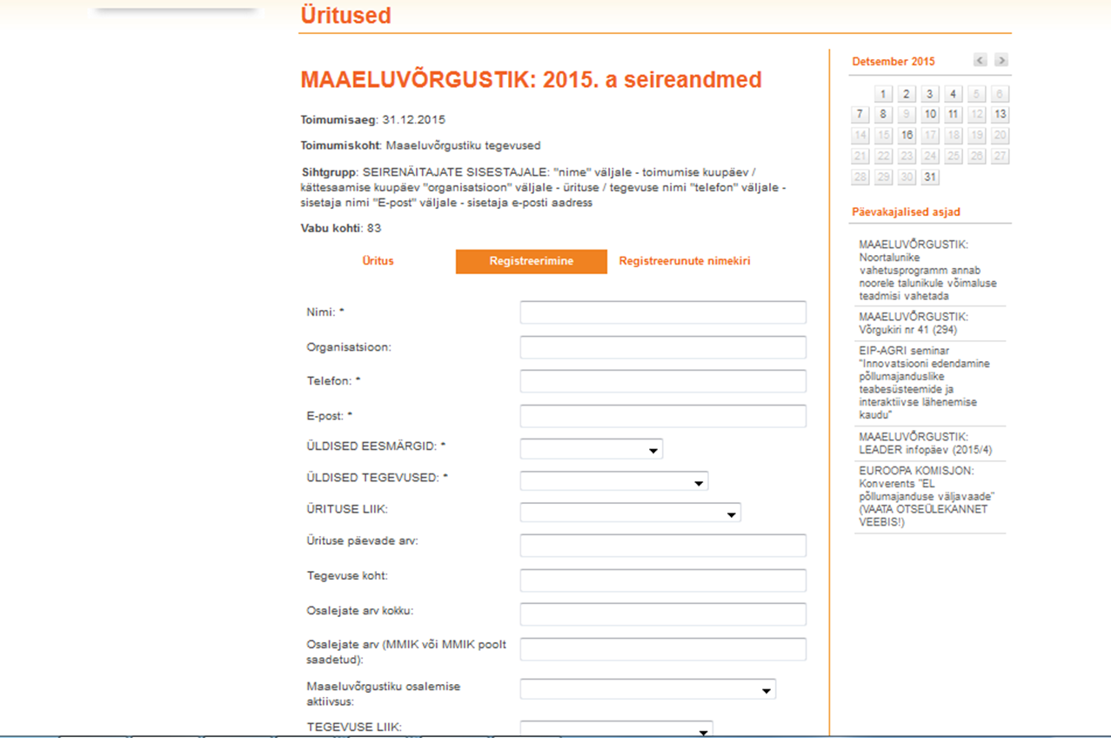
Table for collecting monitoring data

Slide 6
The process of collecting and processing the monitoring data
Web-based database (used the available resources of current web-page)
Data is entered into the table after the concrete activities (event, publication etc.)
All the data is converted to Excel for processing it
Analysing in Excel
The results are presented in special report blanks

Slide 7
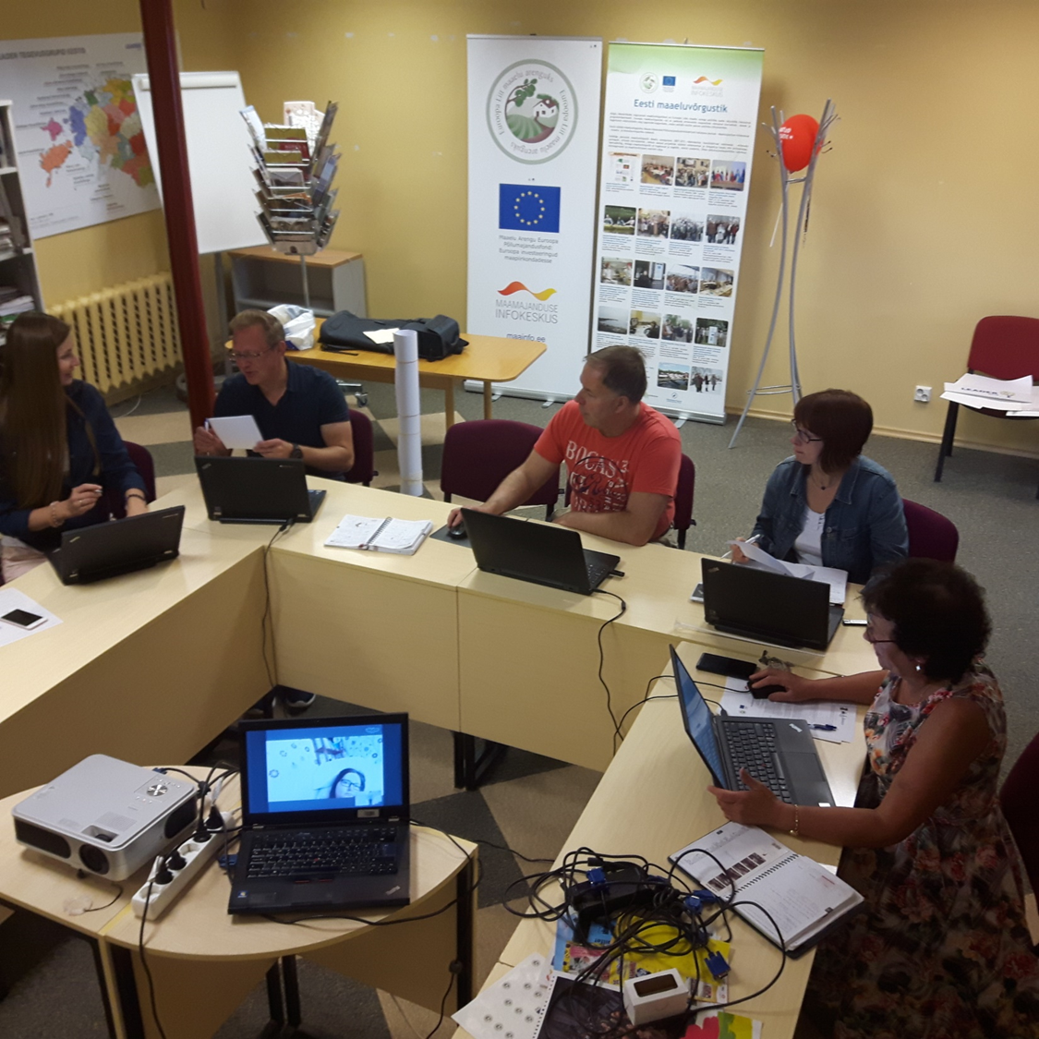
Typical meeting of Estonian NSU self-evaluation ☺

Slide 8
Our self-assessment system - the pros and cons
☺ | ☹
Easy to enter the data | The data don’t run automatically (for example the number of participants)
The data can be entered right after the event or later (flexible) | If You don’t have time to enter the data right away, all the work will grow over your head
All employees of NSU can enter the database and change the data (in case of making corrections) | It is difficult to enter the data for employee, who isn’t „at home“ with the monitoring system
Easy to convert the data into Excel format to process the data | The final report is not automatically generated

Slide 9
What can we do different next time - Lessons learnt
Our own-developed monitoring and evaluation system proved that there is no need for difficult and special web-programme for collecting the data – the one we already have is totally enough!
Collecting and processing the monitoring data can be extremely time-consuming, there might be a need for a special employee for that task!

Slide 10
Some examples of the results of Estonian NRN self-evaluation
In 2015 – we organized 12 events with 682 participants – related to LEADER action group trainings and development activities
We participated 15 different events organized by ENRD during 2014–2015
We made 4 presentations at ENRD events
We disseminated 36 publications of ENRD, that included the translation of 24 of them

Slide 11


Slide 12
Thank You!
Meeri Klooren
meeri@maainfo.ee
www.maainfo.ee

