Slide 1
Importance of using data for effective and sustainable farm management. The Finnish experience.
The Finnish experience
Mtech Digital Solutions, Juho Kyntäjä juho@mtech.fi

Slide 2
Success case Finland/ Mtech
Who are we?
Why have we integrated?
What have we integrated?
What have we learnt?
How about you?

Slide 3
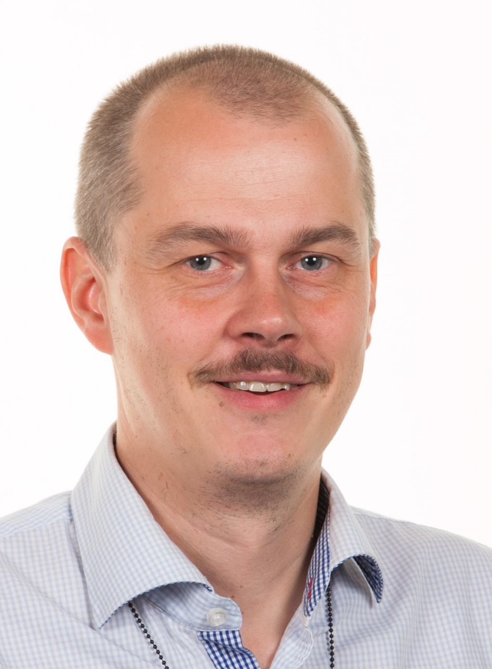
Juho Kyntäjä
2010 -> Mtech Digital Solutions
Senior specialist, development of milk recording, nowadays in the Global unit
Member in the ICAR Milk recording working group since 2014
Chair of the ICAR Certificate of Quality Expert Advisory Group

Slide 4


About Us
More than
More than
Personnel
120
100
20,000
Total Revenue
13.4M€
Farm Customers
B2B Customers
Food industry Advisory organisations Breeding associations Public authorities

Slide 5
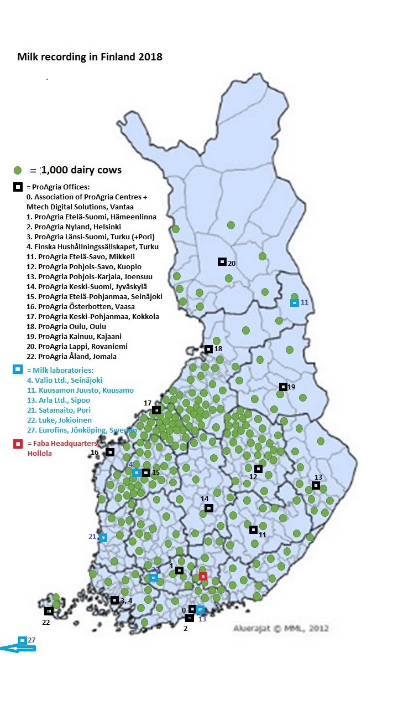
Milk production in Finland
2.2 bln litres per year
3,755 recorded herds in 2021 – 80% of all cows
Average herd size 53.3
Average milk yield 10,073 kg – 4.36 % BF – 3.58 % Protein
Average cell count 179
Breeds
Holstein 56.5 % Ayrshire 41.5 % Finnish cattle 0.8 % Jersey 0.6 %

Slide 6
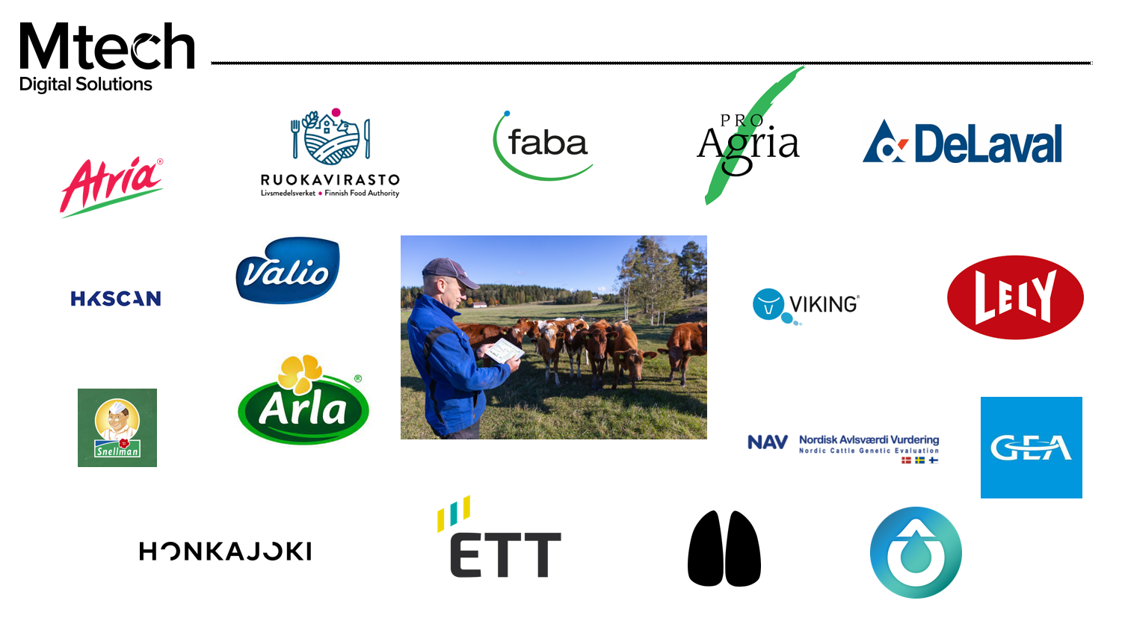

Slide 7

Cattle Movement Register
Births, deaths
On and off movements
Mandatory reporting
Time-limited, sanctioned
Herd management, milk recording, breeding need the same data + much more

Slide 8

Milk recording and dairy advisory
Animal births, deaths and movements
AI & mating data
Milk yield and composition
Feeds & feeding
Stock records
Technologies used
Production costs
Data shared according to actual need
Farmer authorisation

Slide 9


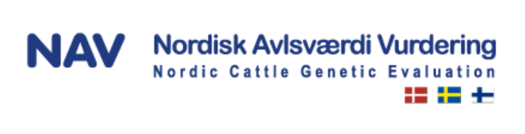
Breeding evaluation & selection
Pedigrees
All cow events
All production data
All health and fertility data
Breeding values
Finding the best animals for next generation
Matching

Slide 10
AI services
Semen logistics
Service orders
Insemination reporting
Error minimisation
Up-to-date reporting
Advisory services

Slide 11



Farm management software
Animal lists
Births, deaths
Milking visits
FMS works on the minute-by-minute level
Milk Recording services have a longer span

Slide 12

Sensors
Heat
Rumination
Movement
Weight
Shape
Health status
Make better use of the data by combining it with other cow information

Slide 13

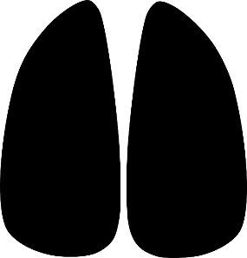
Animal Health data system
Animal illnesses
Treatments + withdrawal times
Hoof treatments
The same data is necessary for herd management
Veterinarians
Abattoirs

Slide 14


Milk buyers
Lab results
Bulk milk data
Cow lists
Up-to-date reporting

Slide 15



Abattoirs
Reporting of animals for slaughter or brokering
Automatic handling of the event
Based on the farmer’s wish

Slide 16

Renderers
Possibility to order transport to rendering when reporting an animal’s death

Slide 17
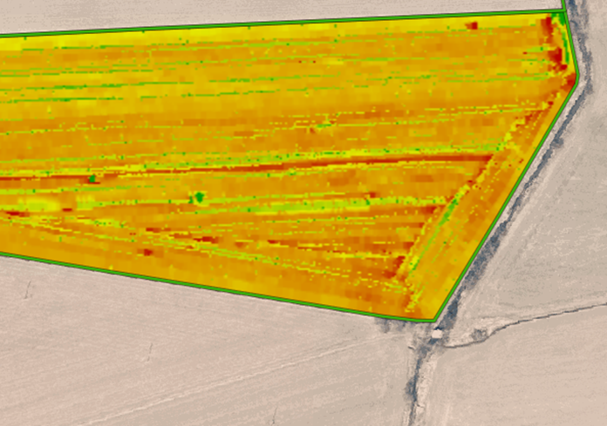
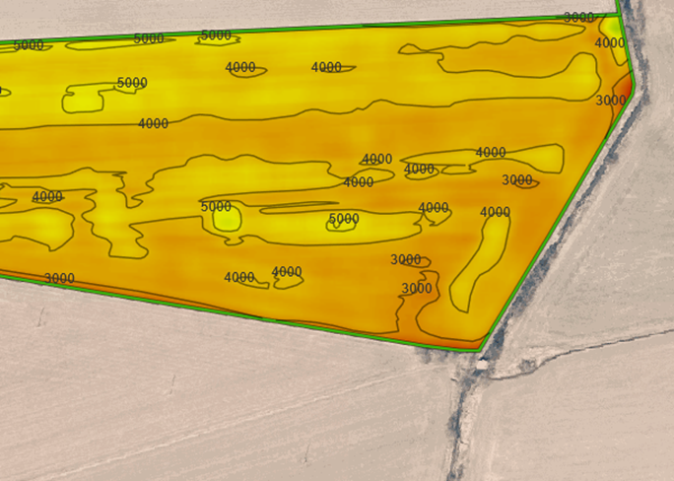
Not just animal data
We also exchange data with field machinery
Precision farming
Fertiliser spreaders, harvesters etc.

Slide 18
What have we learnt?
Mutual trust
Will to cooperate
Information sharing is crucial
Questions?
Scale issues
Join forces!
Save data once – use many times
Error avoidance
Better decision making

