Slide 1



„European Agricultural Fund for Rural Development: Europe investing in rural areas.”
The NRN evaluation process in Poland
September 2016

Slide 2
Contents
Introduction to NRN
Responsibilities
Evaluation Plan
Data collection system
Issues

Slide 3
Introduction to NRN
NRN organisational structure consists of: a central unit, regional units, the Agricultural Advisory Centre in Brwinów, Voivodeship Agricultural Advisory Units.
The Minister of Agriculture and Rural Development entrusted a function of a central unit to the Foundation of Assistance Programmes for Agriculture FAPA.

Slide 4
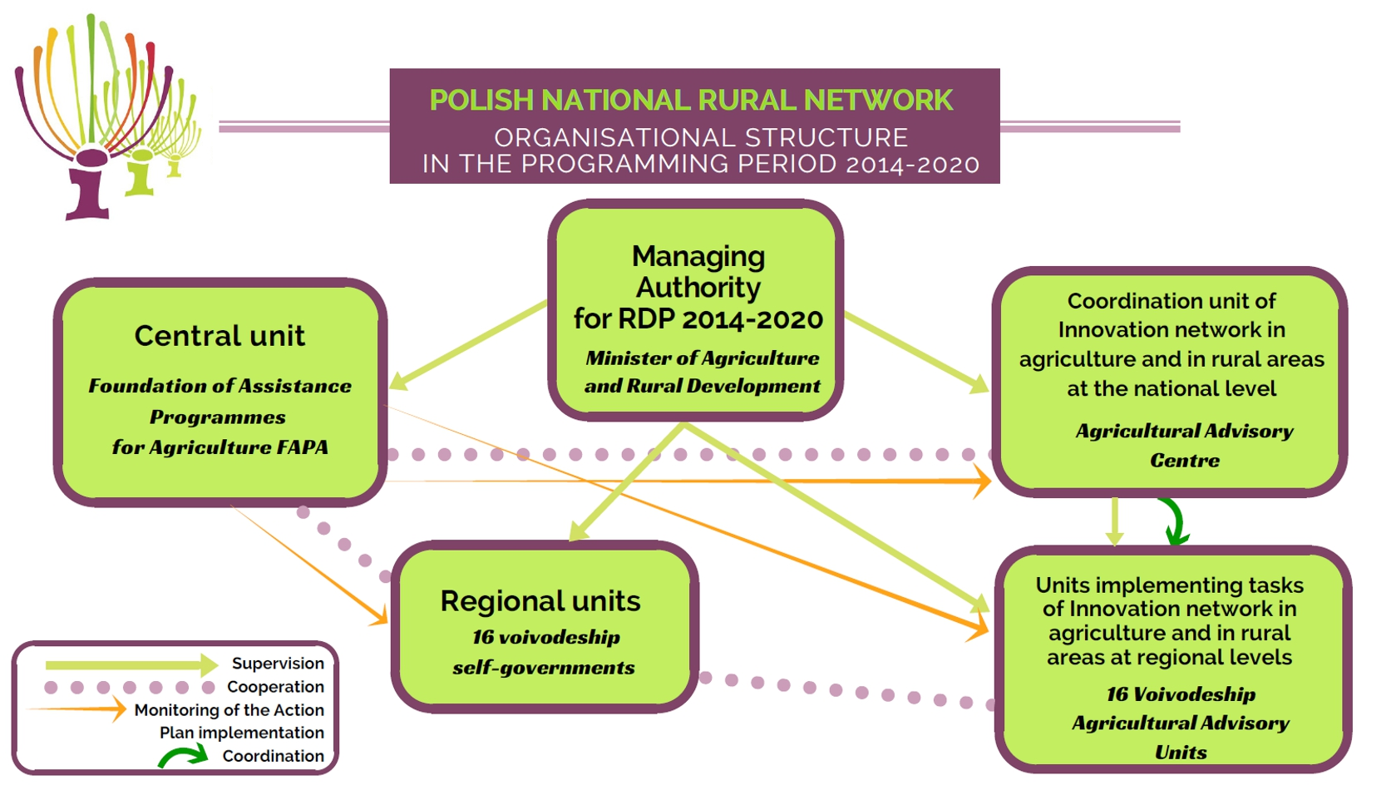

Polish National Rural Network organisational structure in the programming period 2014-2020

Slide 5
Responsibilities for evaluation
Managing Authority (Evaluation unit - Departament of Rural Development in the Ministry of Agriculture and Rural Development).
Evaluation unit commissions preparation of evaluations to external entities or does it itself.
Office of Technical Assistance - Managing Authority for National Rural Network
Evaluation Managing Group was established by the Minister of Agriculture and Rural Development.
Tasks: facilitate cooperation between all institutions involved in the evaluation process and support the evaluation process.

Slide 6
Evaluation Plan in the RDP for 2014-2020
Evaluation of NRN is one of the key areas of the evaluation research regarding RDP. Evaluation of the NRN will include the period July 2015-2023.
Purpose of evaluation: in accordance with the UE legislation
The evaluation Plan covers:
Ex-ante evaluation before implementation of the RDP for 2014-2020 – (already completed in May 2014)
Evaluation during implementation of the RDP (periodical evaluation in 2017, 2019)
Ex-post evaluation after implementation of the RDP.

Slide 7
Evaluation Plan for 2016
1.Evaluation research „Assessment of monitoring and evaluation of the RDP 2014-2020 system.
Objectives:
Assessment of completeness of evaluation questions covered in attachment no 5 to Commission Implementing Regulation (EU) no 808/2014 of 17 July 2014 and of monitoring indicators with regard to usefulness of answering to the questions,
Assessment of usefulness and effectiveness of monitoring and evaluation system,
Assessment of availability of internal and external data sources.
2.Periodical evaluation research of RDP 2014-2020 implementation – planned in IV quarter 2016

Slide 8
Data collection system - 1
Data from all entities responsible for the implementation of the NRN Action plan are reported to a central unit, then they are submitted to the Managing Authority.
Data are collected for different periods:
monthly (M),
every 6 months (6M),
yearly (Y),
every 2 years (2Y).

Slide 9
Data collection system - 2
They cover:
The process of implementation of NRN objectives, NRN activities and RDP supporting priorities including quantity and financial data (M,6M,Y,2Y);
The results of a two year Operational plan implementation indicating quantity data (monitoring indicators consistent with Common Network Statistics in the EU) (6M,2Y);
The results of the Action plan implementation indicating quantity data (monitoring indicators consistent with Common Network Statistics in the EU) (Y);
The results of the tasks implementation in the scope of information on RDP – measures undertaken in order to ensure RDP dissemination in accordance with Regulation (EU) No 1305/2013 (6M,Y,2Y);
Information on inspections carried out in the scope of NRN functioning and implementation of the Action plan (Y);

Slide 10
Data collection system - 3
The results of the NRN Action plan implementation indicating quality data (analysis of evaluation questionnaires regarding training, all good practices collected and published in good practice database, number of partners identified and interested in cooperation within LEADER axis or within „Cooperation” measure, number of submitted applications for cooperation projects within LEADER axis or within „Cooperation” measure) (Y);
Description of at least 5 projects coming from different NRN activities that were implemented within Operational plan (2Y);
Suggested changes to Operational plan, guidelines, recommendations of the Voivodeship working groups (6M,2Y);
Activities of Voivodeship working groups - measures undertaken in order to ensure NRN partners involvement in accordance with Regulation (EU) No 1305/2013 (Y).

Slide 11
Issues
One of the NRN Action Plan activity refers to dissemination of information of the results of monitoring and evaluation of supporting development of rural areas in the financial perspective 2014-2020
Data dissemination - What kind of data? Who are the addressee?
/thematic groups, researchers, NRN partners registered in the partners’ database,…?/

Slide 12

Thank you
Agata Markuszewska
National Rural Network Coordination Unit
Foundation of Assistance Programmes for Agriculture FAPA
a.markuszewska@fapa.org.pl
www.ksow.pl

